Slide 1


Slide 2




KEEP BREATHING
Scared to face the public?
41% people in North America are
It’s a privilege, an opportunity
Present your ideas and philosophies.

Slide 3



GET READY TO GET STARTED
Plan your presentation
Get familiar with the equipments
Connect well with the chair-person
Its not a one man show.

Slide 4


YOUR DRESS IS YOUR REFLECTION
Put on your best suit.
Dress should be immaculate and
appropriate.
Shouldn’t go against your
presentation

Slide 5


START IN STYLE
First impression is the last impression
According to psychologists
People form their opinion
within 15 seconds.

Slide 6




TRY TO BE DIFFERENT
Audience are bored of repetitiveness
Start with a foundational phrase
Create a story
Raise questions in their mind

Slide 7


PIP STORY FORMAT
Divide the story in three parts (PIP)
A Phoundational phrase.
Illustration of the story.
Point/lesson learned

Slide 8


DON’T SHOUT OR WHISPER
NOT TOO SOFT NOT TOO LOUD
YOU SHOULD BE EASILY AUDIBLE

Slide 9

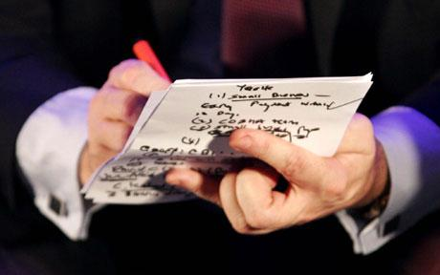
TAKE NOTES
Keep some notes close to you
Don’t feel shy
No one can memorize everything
Even Martin Luther king kept notes.

Slide 10
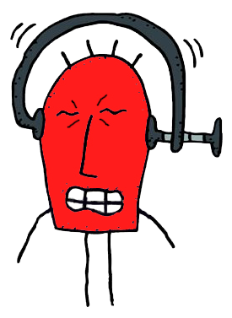

MEMORIZE BUT NOT TOO MUCH
Try to memorize some points
Don’t over saturate
your mind
Really helpful in early nervous moments.

Slide 11


EYE CONTACT
A key indicator of veracity
Impossible to lie keeping eye contact
Look at people just above eyes
Keep a constant flow of your eyes.

Slide 12
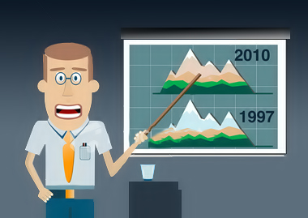
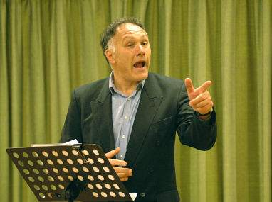
CONTROL YOUR ANXIETY
Its natural, don’t panic
Keep stretching a little bit
Drive attention away from
yourself
Talk about the audience, raise questions.

Slide 13


GESTURES
Medium of non-verbal communication
Avoid “hands in pocket”
Dynamic speakers use their
hands effectively.

Slide 14

DON’T FREEZE
Walk around a little bit
But don’t keep walking
Follow this rule of three
WALK, STOP, TALK.

Slide 15


POWER OF THE PAUSE
Don’t just start reading an essay
Give them a little, create hunger
Let them understand,
analyze, associate
Then speak.

Slide 16
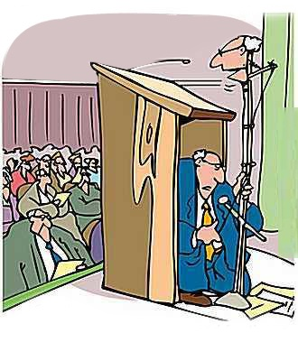

WHERE TO STAND
Don’t hide behind the podium
Always stand on the left
Presentations always
start from the left
Audience will always
see you first.

Slide 17


A GOOD FINISH
Don’t finish abruptly
Let them know its about to finish
Give them something to think
A question or an advice.

Slide 18


